Slide 1

FTR Railcar Forecast Accuracy Report
Calendar Year 2018

Slide 2
The FTR Process
FTR takes the development of our forecast very seriously. We combine the expertise of nine skilled individuals with over 250 years of combined industry experience to produce our equipment forecasts. Each month we review and analyze hundreds of quantitative and qualitative data points during six hours of meetings, over a seven day period. In addition, we spend countless more hours aggregating and updating our numerous datasets and writing our commentary for our monthly reports.
Our process may appear to be excessive, but we are passionate about delivering accurate and reliable forecasts to our customers. We know companies are relying on these forecasts to make important business decisions and we have determined that our process produces the best forecast results.
At the end of the process, we publish forecasts that are data driven and based on solid, verifiable assumptions explained and presented in the Rail Equipment Outlook report. It is this level of detail and analysis that has established FTR as the most reliable and most trusted forecasting firm in the transportation industry.

Slide 3
Total N.A. Railcars
Annual
Final North American railcar deliveries for 2018 were 50,803 units.
The 2018 forecast was essentially within the 20% range throughout the 3 year horizon, although it did drop just out of that range for a single quarter.
The one year forecast was off by just 1,770 units, or 3.5%.
By the one year mark the overall forecast was essentially right on the mark, although the mix of railcar types did shift during that time.
Gray box represents +/- 20% range

Slide 4
N.A. Railcar Deliveries
Green Box represents acceptable range of forecast error.

Slide 5
Total N.A. Railcars
Quarterly
At one year out, the overall annual figure just 13% off, but the quarterly assessment did not come to pass.
Gray box represents +/- 20% range

Slide 6
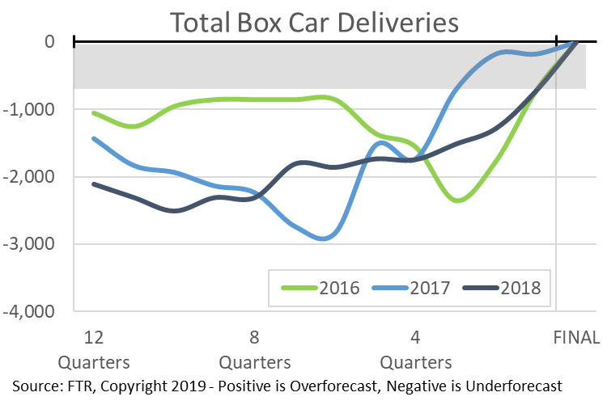
Box Cars
Annual
Final North American Box deliveries for 2018 were 3,811 units.
After dropping close to zero deliveries in 2015, the Box Car market returned in 2016 and stayed close to those levels in both 2017 and 2018.
Since this market is only producing a few thousand units per year, the forecast error on a percentage basis shows high variation.
Gray box represents +/- 10% range

Slide 7
Covered Hopper
Annual
Final North American Covered Hopper deliveries for 2018 were 23,155 units.
The 2018 Covered Hopper forecast quickly moved higher on the heels of a stronger than expected 2017.
However, an overcorrection occurred and we were notably above the final numbers during most of 2018. Much of this was due to the reduction in need for long-haul frack sand and weak ag markets.
Gray box represents +/- 20% range

Slide 8
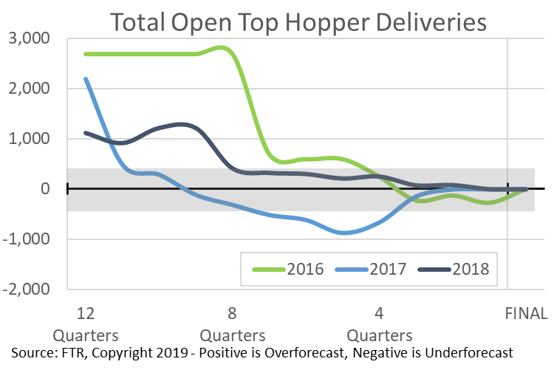
Open Top Hopper
Annual
Final North American Open Top Hopper deliveries for 2018 were just 886 units.
The 2018 Open Top Hopper forecast was within 500 units at 2 years out.
Since this market is producing just a thousand units per year, the forecast error on a percentage basis shows high variation.
Gray box represents +/- 20% range

Slide 9
Gondola
Annual
Final North American Gondola deliveries for 2018 were 2,740 units.
After seeing a sharp reduction in 2017 expectations, the 2018 forecast has been essentially spot on. At most, it was just 650 units off the final result.
The 2017 Gondola forecast was initially much too strong but quickly moved down. The sharp reduction in coal moves that began in 2015 was the primary factor for the reduction.
Since this market is now only producing a few thousand units per year, the forecast error on a percentage basis shows high variation.
Gray box represents +/- 20% range

Slide 10
Flat Car
Annual
Final North American Flat deliveries for 2018 were 9,756 units.
The 2018 Flat forecast moved steadily in the correct direction starting more than two years out.
Unfortunately, it was outside of the 20% threshold until we were within the one year mark.
Gray box represents +/- 20% range

Slide 11
Tank Car
Annual
Final North American Tank deliveries for 2018 were 10,455 units.
The 2018 Tank forecast was quite stable, following several years of severe swings.
The forecast hit the 20% threshold at 7 quarters out. It was just 1,225 units over the final results at 3 quarters out.
Gray box represents +/- 20% range

Slide 12
Addendum

Slide 13
Railcar Deliveries
14 Year View
Note that the years 2009 and 2010 go off the charts due to the dramatic reductions in expectations stemming from the Great Recession.
It is essential to remember that 2009 was the steepest downturn the transportation industry has seen in at least 30 years – perhaps longer.
Our railcar delivery forecasts began in 2004 so there is only limited data for 2004-2005.
Recession Years: 2008-2010
Gray box represents +/- 20% range

Slide 14
N.A. Box Car Deliveries
Green Box represents acceptable range of forecast error.

Slide 15
N.A. Covered Hopper Deliveries
Green Box represents acceptable range of forecast error.

Slide 16
N.A. Gondola Deliveries
Green Box represents acceptable range of forecast error.

Slide 17
N.A. Open Top Hopper Deliveries
Green Box represents acceptable range of forecast error.

Slide 18
N.A. Flat Car Deliveries
Green Box represents acceptable range of forecast error.

Slide 19
N.A. Tank Deliveries
Green Box represents acceptable range of forecast error.

Slide 20
Box Cars
Quarterly
Box Car deliveries started off the year very close to expectations but ramped up significantly during the back half of the year.
Gray box represents +/- 10% range

Slide 21
Gondola
Quarterly
Gondola deliveries weren’t dramatically off of expectation, although the market stayed strong to end the year rather than easing.
Gray box represents +/- 10% range

Slide 22
Covered Hopper
Quarterly
Covered Hopper deliveries started the year off stronger but ended the year much closer to FTR’s expectations.
Gray box represents +/- 20% range

Slide 23
Open Top Hopper
Quarterly
Open Top Hopper deliveries started the year near expectations but by Q3 had moved in a completely different direction.
Gray box represents +/- 20% range

Slide 24
Flat Car
Quarterly
Flat Car deliveries followed the general trend but came in much stronger than initially anticipated.
Gray box represents +/- 20% range

Slide 25
Tank Car
Quarterly
Tank Car deliveries started the year weaker, but following the expected pattern. By Q4 the market had shifted and deliveries continued to increase.
Gray box represents +/- 20% range

