Slide 1
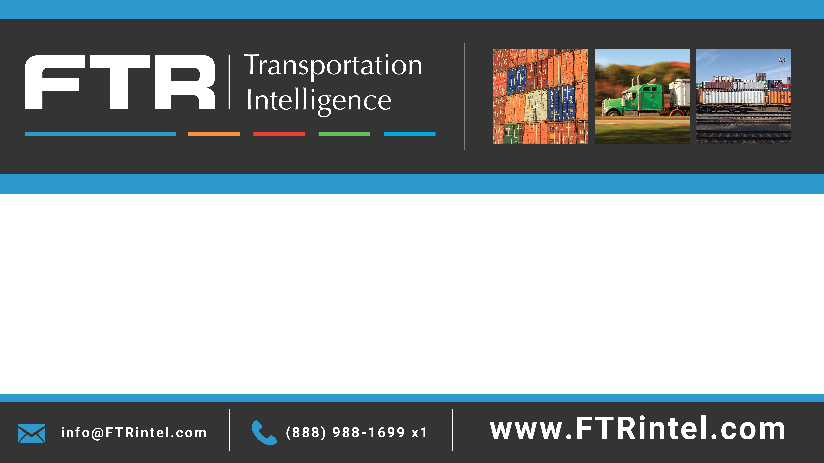
Transportation Overview
Eric Starks
Chairman and CEO
FTR
estarks@ftrintel.com
888.988.1699 x41

Slide 2
Modes of Freight Transportation
Truck
Rail
Water
Pipeline
Air

Slide 3
6 Foundations and Building Blocks of Transportation Planning
Economy
Freight Demand
Capacity
Fluidity/Congestion
Productivity
Rates & Costs

Slide 4
Freight Basics
Basic Metrics
    Tons
    Tonmiles
    Loadings Originated

Slide 5
Understanding Trucking Freight Seasonality
Source: American Trucking Association (ATA)

Slide 6
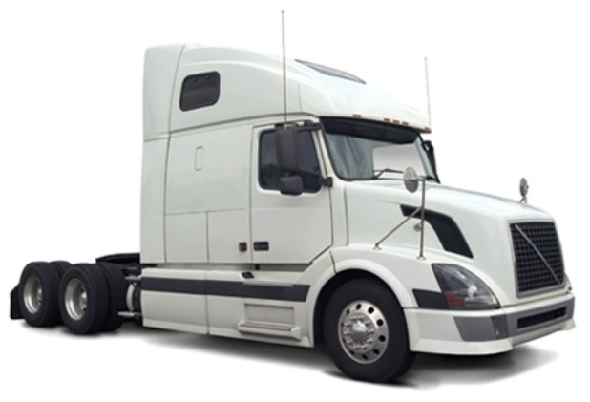
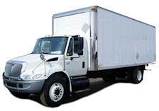
Truck Power Units
Tractor
  Can haul a trailer on the back by connecting it via a “fifth wheel”
Straight Truck
  Chassis will hold a body on the back and is a self contained unit

Slide 7
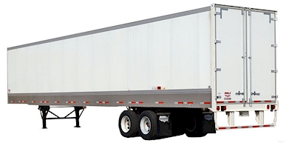
Dry van Trailer
A simple, enclosed non-climate controlled rectangular trailer that carries general cargo, including food and other products that do not require refrigeration. Usually loaded/unloaded through the rear doors, requiring elevated access for forklifts to enter the trailer

Slide 8
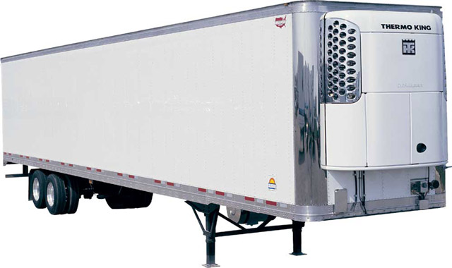
Reefer Van Trailer
Also known as a Refrigerated van
    A refrigerated and insulated box trailer.
An enclosed climate controlled rectangular trailer that typically carries temperature sensitive
cargo, including
refrigerated or frozen
food and other products
that require refrigeration.

Slide 9
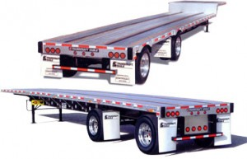
Flatbed Trailer
A flat trailer with no enclosure or doors. Can be loaded/unloaded from the sides or above, and does not require elevated access for forklifts.
Sometimes referred to as a Platform Trailer by manufacturers.

Slide 10
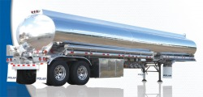
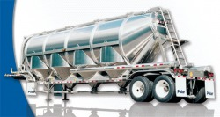
Tank Trailer
An enclosed cylinder-shaped tank used for hauling bulk quantities of liquid or dry items.
Liquid Tanks would
carry items such as
chemicals and fuel.
Dry Tanks would carry
items such as flour or cement.

Slide 11
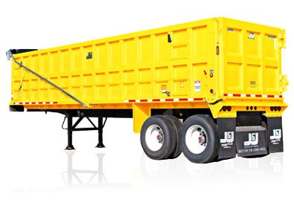
Bulk Trailer
Used for several applications that move large and heavy bulk items. This could include sand, gravel, coal, scrap material, and more.
Image is of a dump trailer

Slide 12
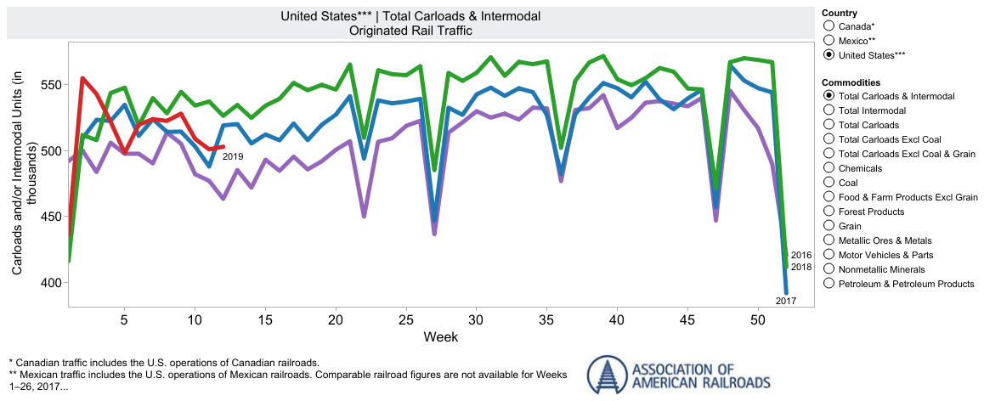
Understanding Rail Seasonality
Source: Association of American Railroads; aar.org

Slide 13
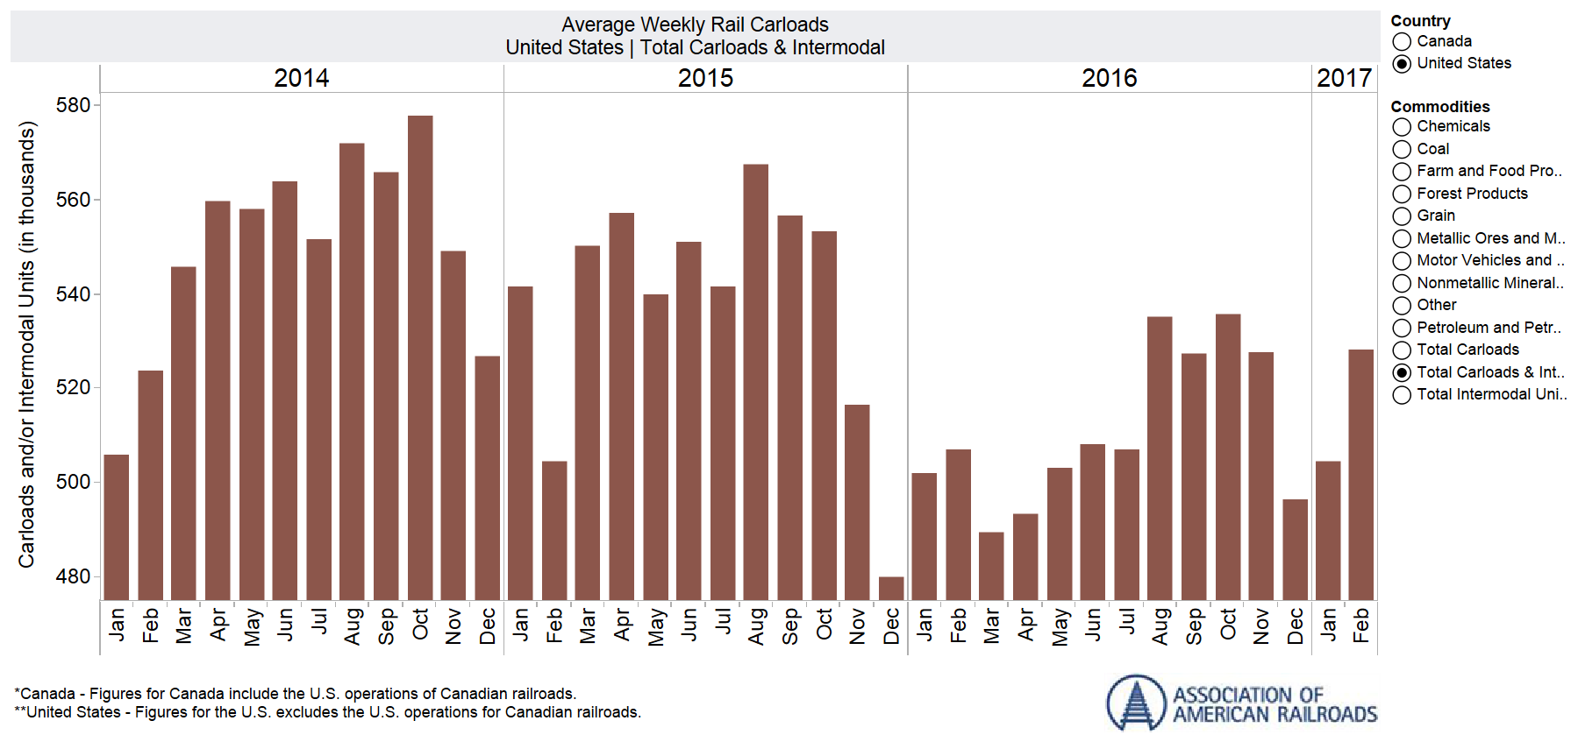
How the data is presented can sometimes tell a better story…can you see the seasonality?
Source: Association of American Railroads; aar.org

Slide 14
Intermodal: Domestic vs International
Average Monthly Loads 2010-2018
(North America)
International
Domestic
Note: Data change in January 2015 to include all North American Data.
Source: FTR Intermodal Update, IANA ETSO
Notes:
Updated 04/1/2019

Slide 15
Intermodal Split
North America Loadings Originated by Equipment Type
Source: FTR Intermodal Update, IANA ETSO
Notes:
Updated 4/2/2018

Slide 16
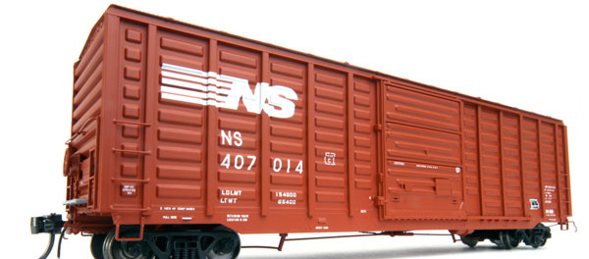
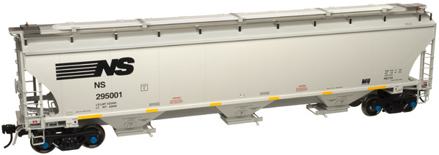
Rail Car Types
Box Car
Covered Hopper

Slide 17
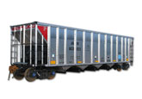
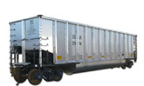
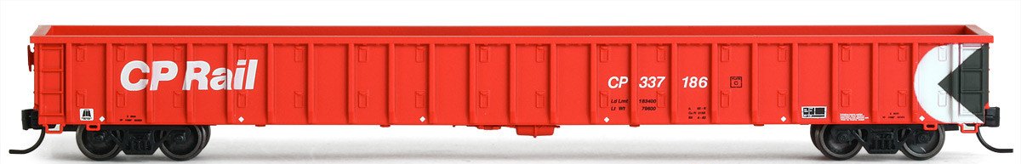
Rail Car Types
Open Top Hopper
Gondola

Slide 18
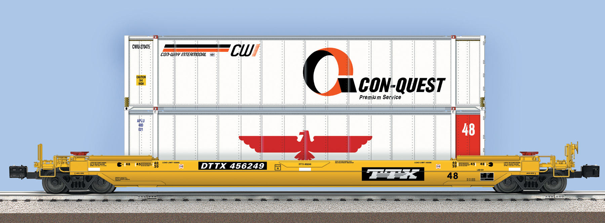
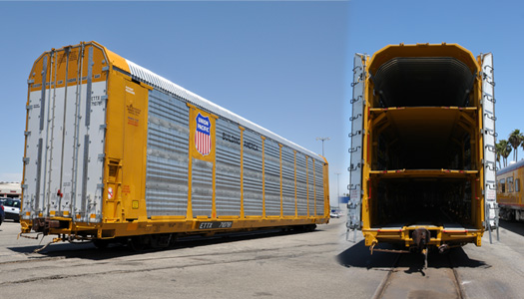
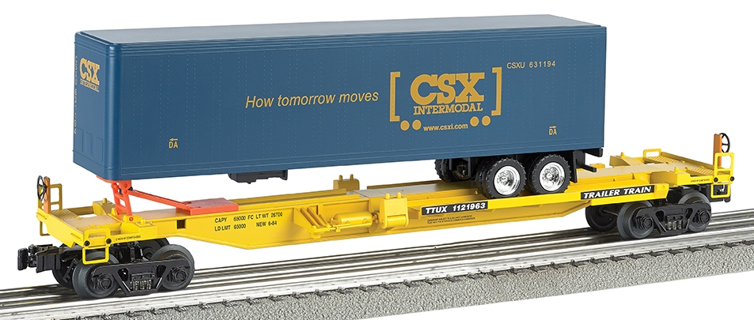
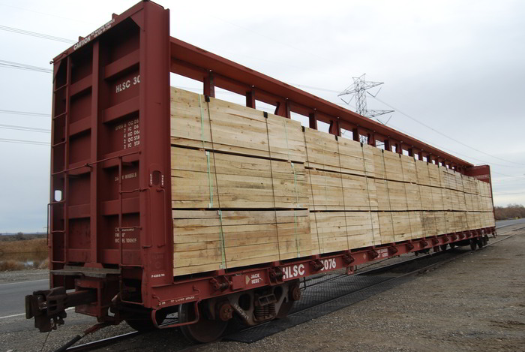
Rail Car Types
Flat Cars

Slide 19
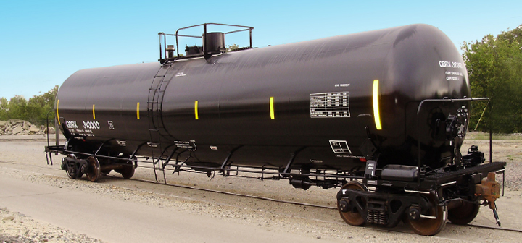
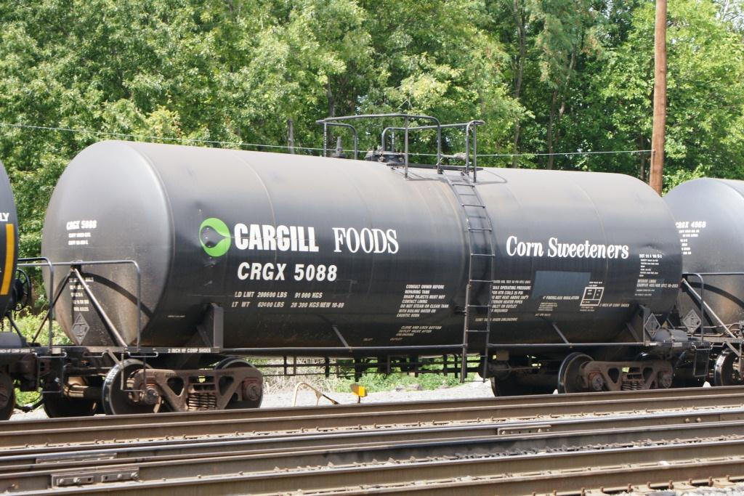
Rail Car Types
Tank Cars

Slide 20
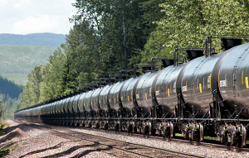
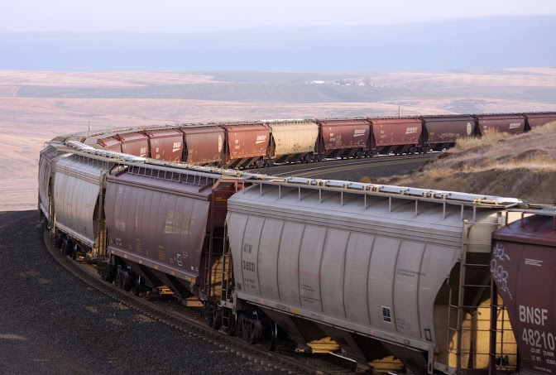
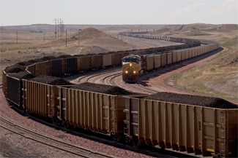
Unit Train

Slide 21
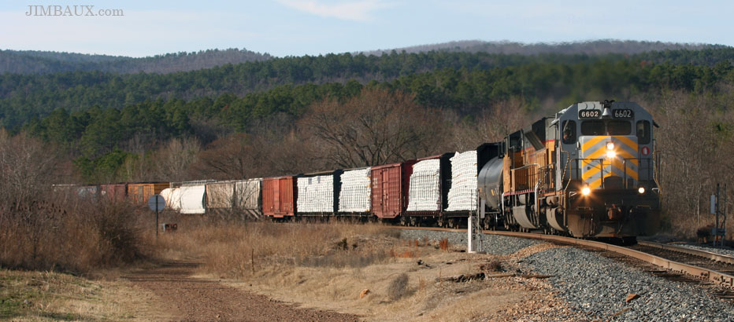
Manifest Train

Slide 22
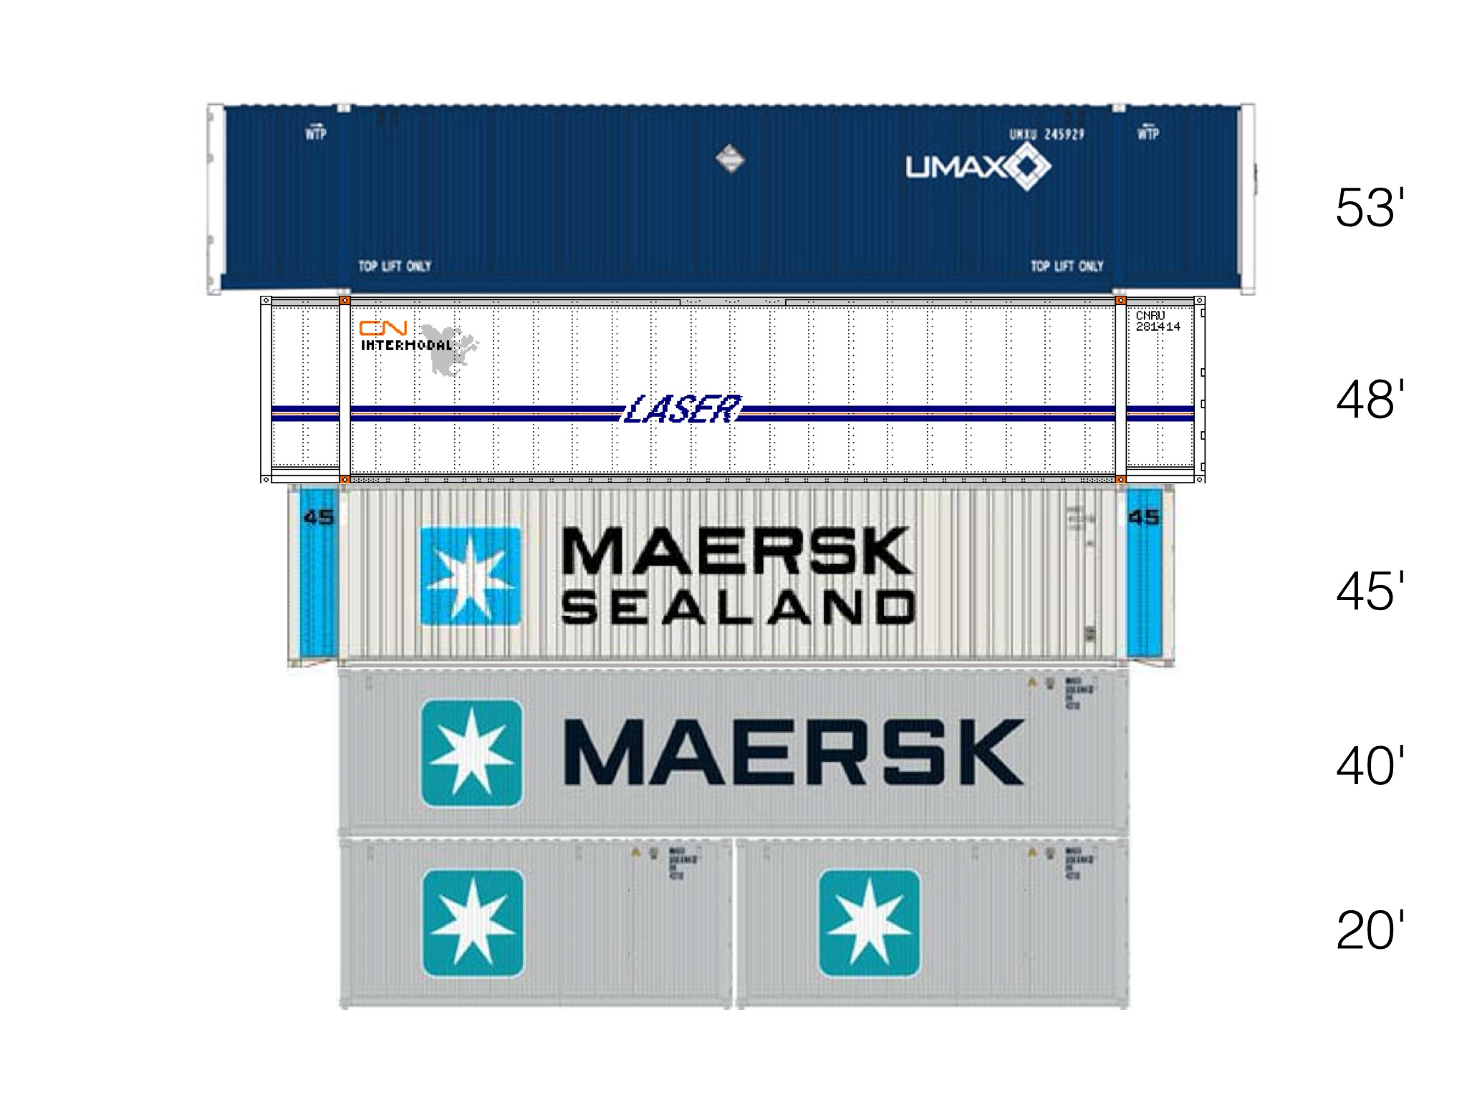
Containers…
Domestic
International

Slide 23
TEU: What is it?
International Containers come in 20, 40, and 45 foot lengths
The industry converts all metrics back to
“Twenty-foot Equivalent Units”

Slide 24
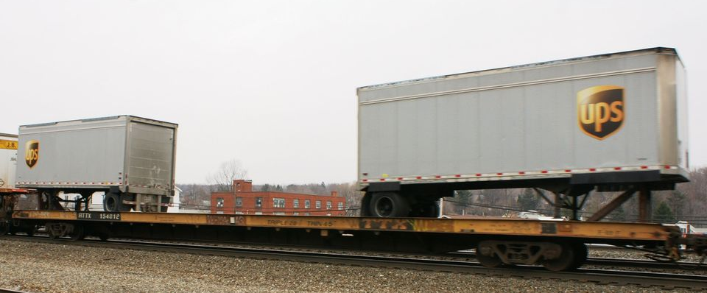
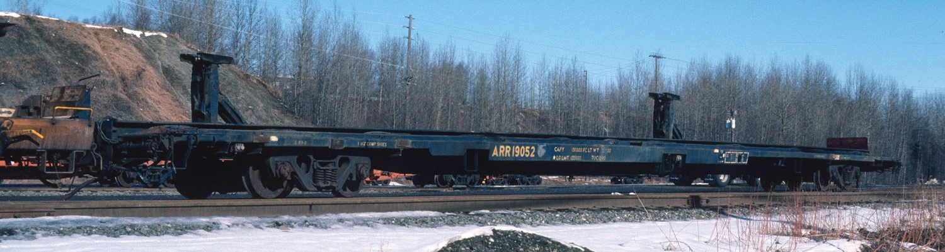
INTERMODAL
Trailer on Flatcar (TOFC)

Slide 25
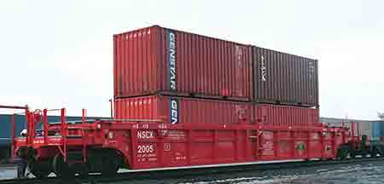
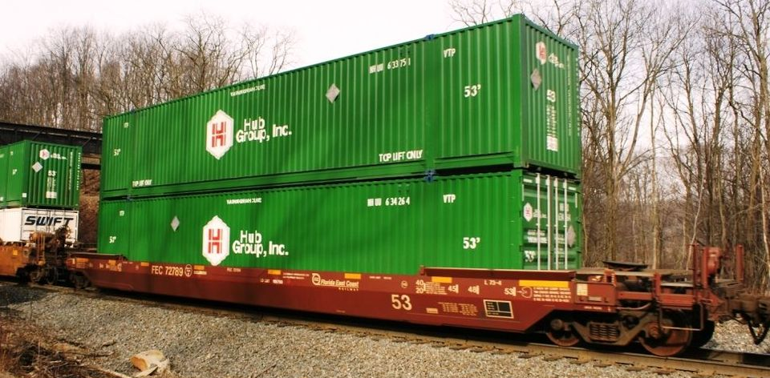
INTERMODAL
Container on
Flatcar (COFC)

Slide 26
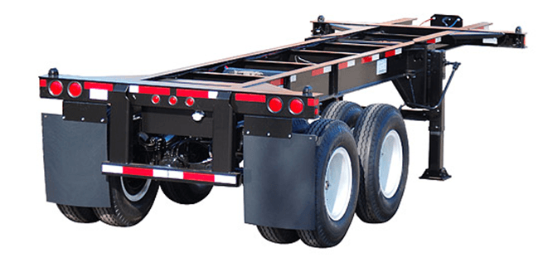
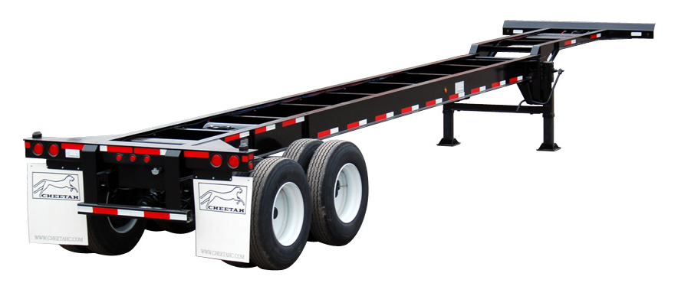
INTERMODAL
Chassis

Slide 27
Drayage
Transporting goods a short distance via ground freight or the charge for such a transport.
In freight forwarding, drayage is typically used to describe the trucking service from an ocean port to a rail ramp, warehouse, or other destination.

Slide 28
What items impact capacity utilization?
Freight Demand
Productivity
  Trying to come up with “turn time” on the equipment
    Distance moved
    Size per load: Weigh out vs Cube Out
    Hours moving
    Speed
    And much more

Slide 29
Weigh out vs cube out
Size Per Load = Tons/# Loads
    By calculating the size per load we can see if the freight is weighing out or cubing out
Weigh Out:
    When a load reaches it maximum weight capacity and cannot be filled any more due to weight limits on the unit or regulations
      Example would be steel which is very heavy and reaches a maximum load size before filling up the unit
Cube Out
    This occurs when a unit is filled to its maximum space capacity but does not reach its maximum weight limit.
      Example would be a load of pillows which is not very heavy but quickly fills up the unit.

Slide 30
There are three things you can get when shipping items
Good Service (Quality of Service)
Fast (Speed)
Cheap (Low Cost)
Pick 2!!!

Slide 31
Decision Matrix
 | Criteria 1 | Criteria 2 | Outcome
Scenario 1 | Good (Service) | Fast (Speed) | Expect to Pay more
Scenario 2 | Good (Service) | Cheap (Low Cost) | Anticipate Slower Delivery Time
Scenario 3 | Cheap (Low Cost) | Fast (Speed) | Expect Poor Service

Slide 32

www.FTRintel.com

